Slide 1
CampusMap - CSC 6370 Project
Wasfi Momen
April 4th, 2018

Slide 2
Purpose and rationale

Slide 3
The University
Ask more from your University
Parking, Finances, Space; All data that can be collated
Systems already exist to manage Universities at scale

Slide 4
A Campus Map
A campus map consolidates lots of University services
But students, faculty, and staff want and need more
Goal: create a social map with database input. Anything can be a database should be a topic users can subscribe to.

Slide 5
Technologies and implementation

Slide 6
Building a map in the now
Using Ionic 4 the frontend
Experience in angular
Full mobile and web parallel development
MVC
Localstorage
Backend: Still up for debate
Want to experiment with document oriented db
Couchdb? Mongodb?
In the end, as long as Json returns I'm happy
Database Model
Schema: There is none!
Unique I'd for user
User actions (like subscriptions to data) will modify certain document views (or tables)

Slide 7
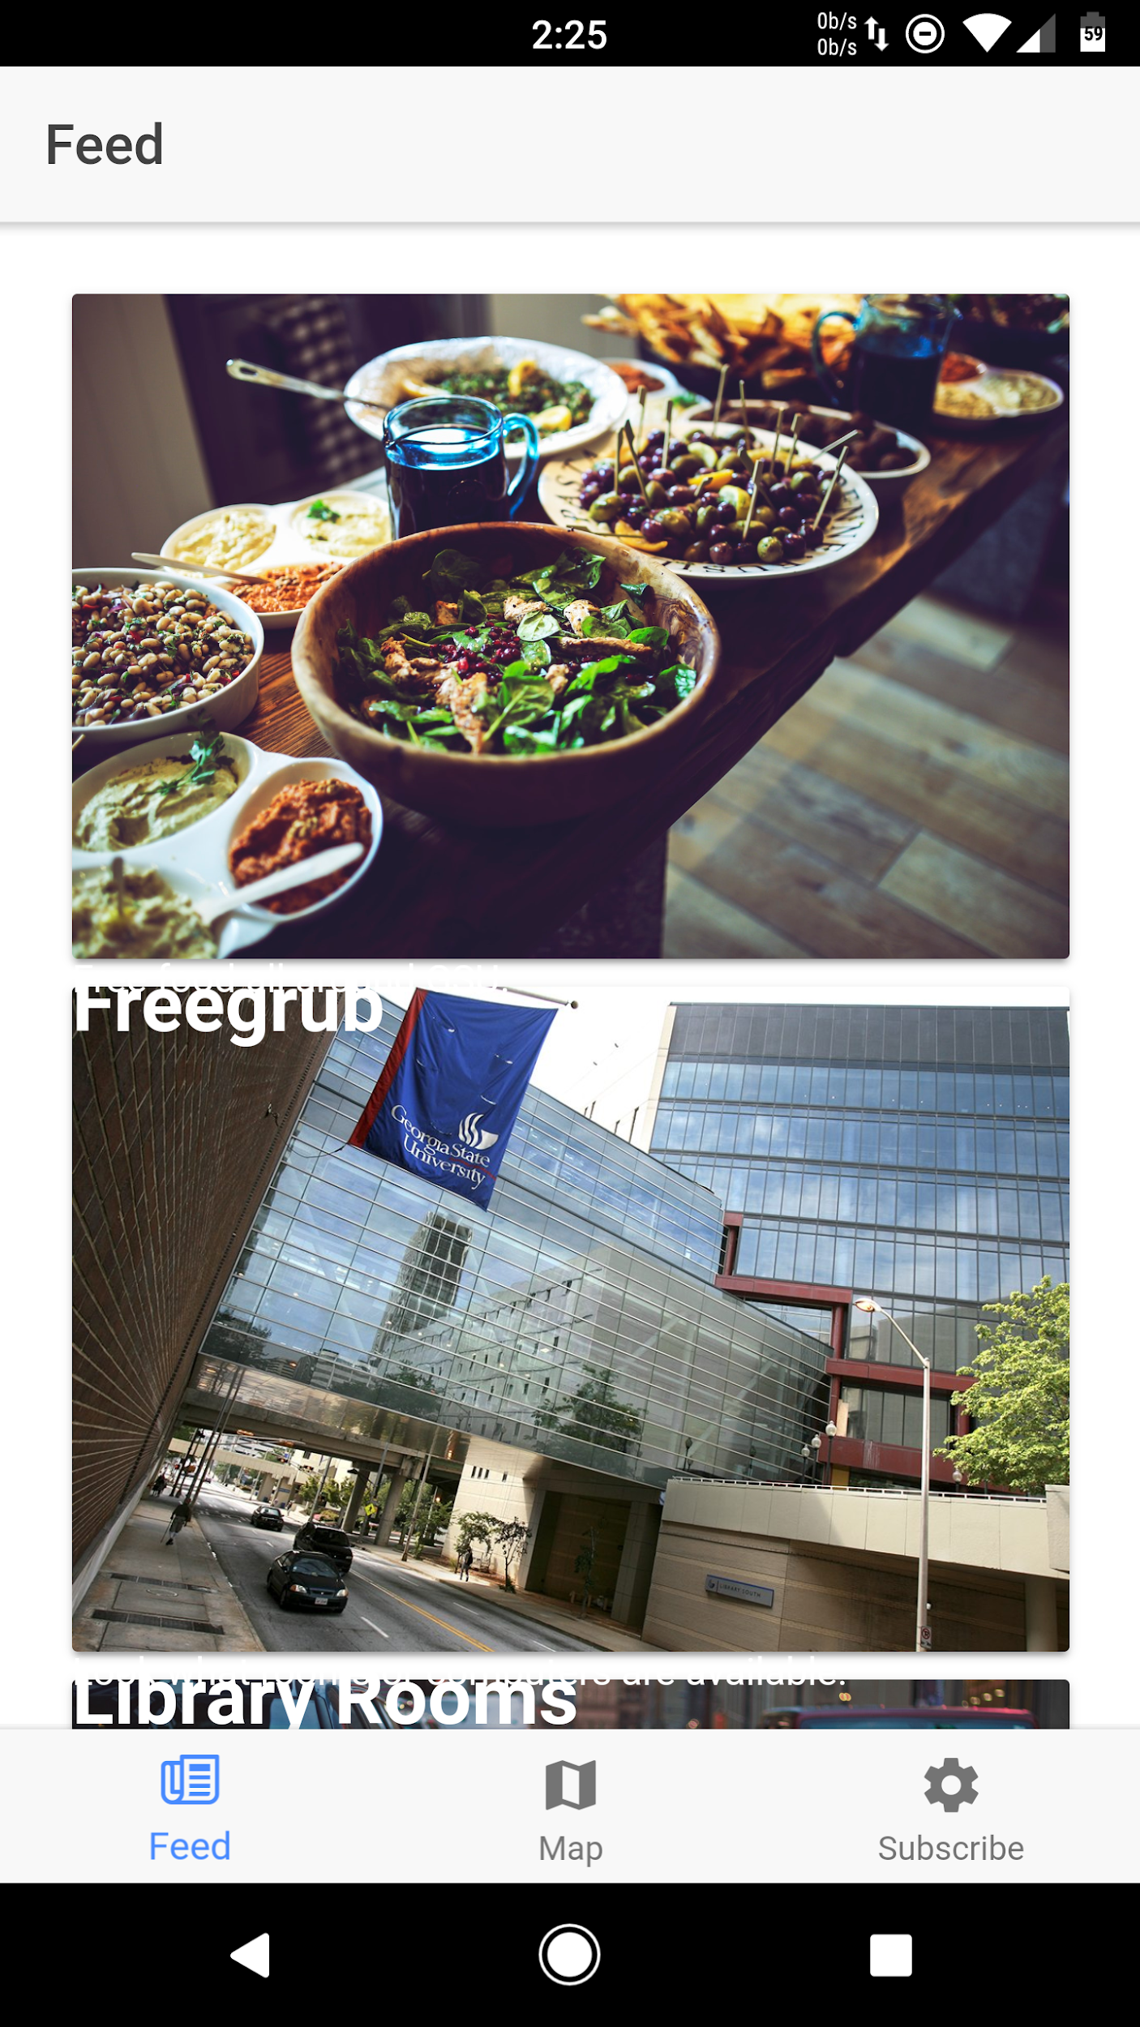
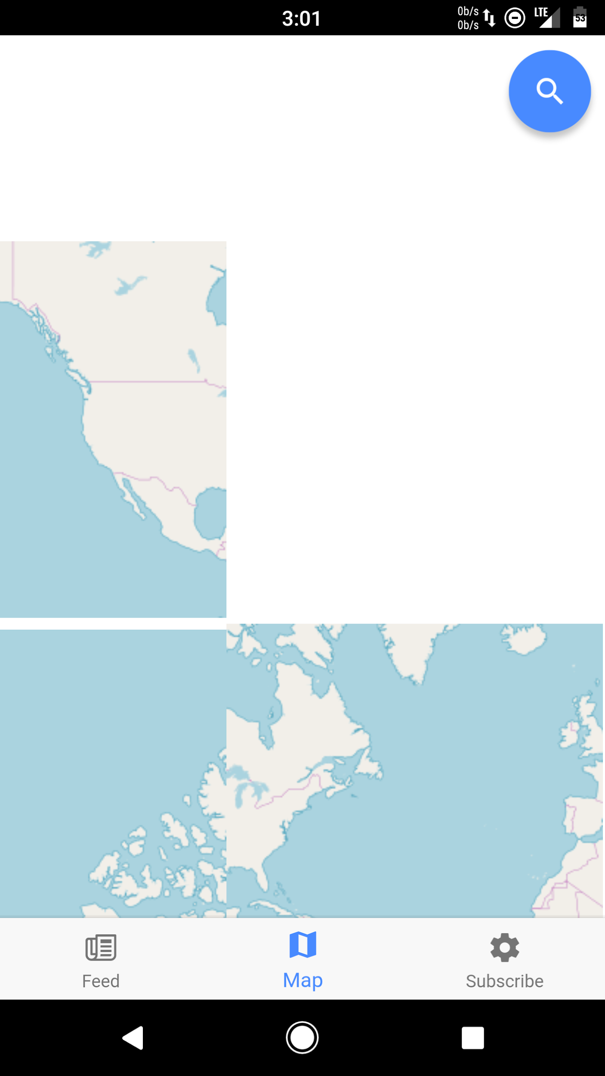
Screenshots of current app

Slide 8
Further work
Scanning current records using Python beautiful soup and set up a CI process
Deciding on backend
Less than 60,000 students
Function specific
Provide an API

